Slide 1
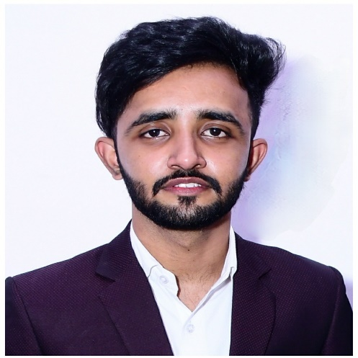











Find me
Sandeep Singh
https://shorturl.at/joR23
sandeepsinghs321@gmail.com
Go Developer
Bangalore, Karnataka
+91 8114421051
Education
HKBK College Of Engineering (2019-2023)
Bachelor in Computer Science And Engineering
Training And Certifications
TEKsystems , Bangalore Oct 2023 - Dec 2023
Go Lang Training
Pentagon Space, Bangalore May 2023 – Sep 2023
Java Full Stack Training
About Me
I recently graduated in Computer Science and love coding and solving problems. I'm familiar with various programming languages and frameworks, and I'm eager to bring my fresh perspective to innovative tech projects.
I come from Jodhpur, Rajasthan, and my dad serves in the army. Growing up in a military family taught me discipline and resilience. I'm excited to use my skills to contribute in the tech industry.
Interests
Photography
Sports
Travel
Volunteering
Music

Slide 2

Project
Title :- Job Portal
This project enables users to sign up, browse company job listings, and apply for positions. HR representatives can post job openings and manage the recruitment process, fostering a streamlined interaction between job seekers and employers.
I use the Gin framework in this project because it helps me manage HTTP requests and responses more efficiently.
I implemented JWT token authentication in the middleware for enhanced security during user authentication.
The project's data storage is implemented using Gorm, further facilitating seamless data management.

